Slide 1

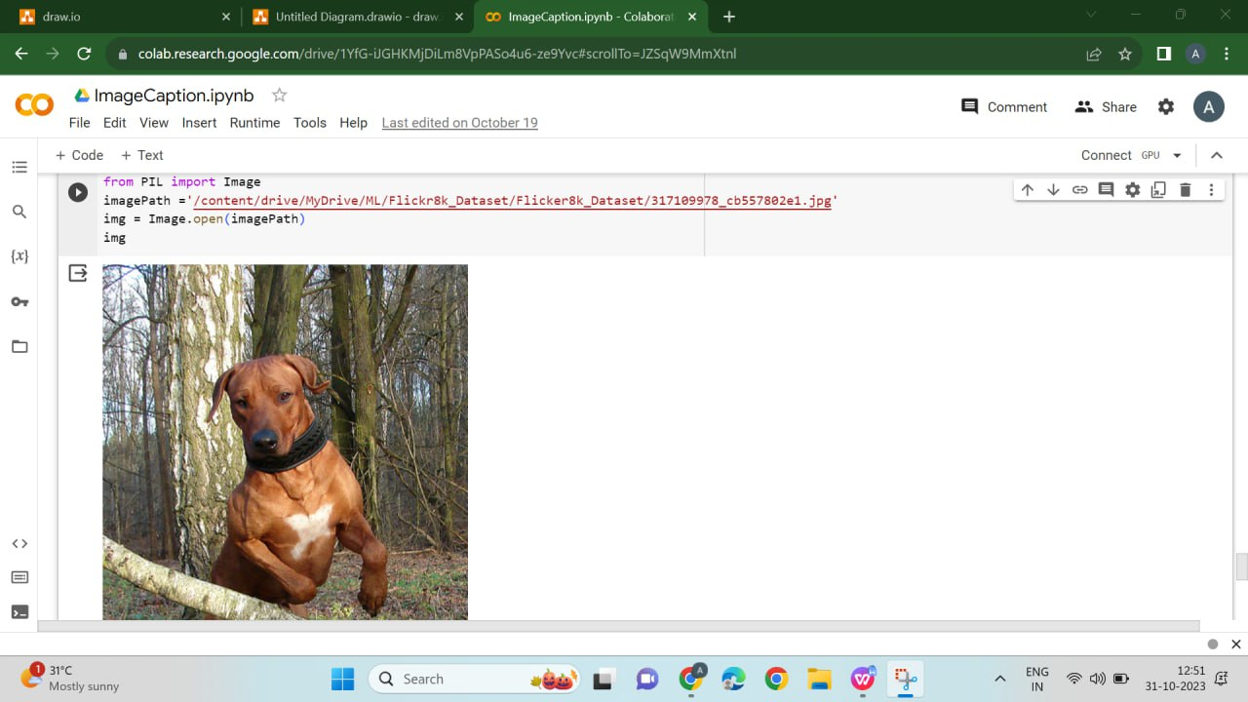
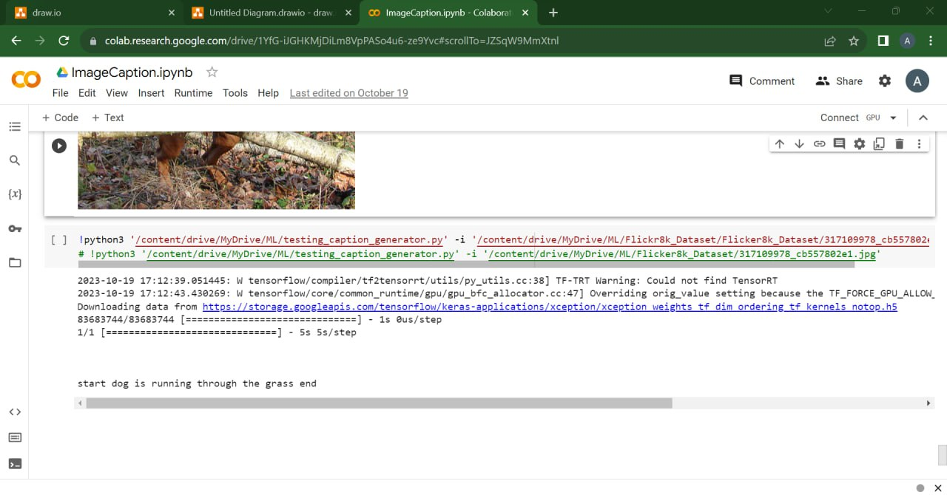
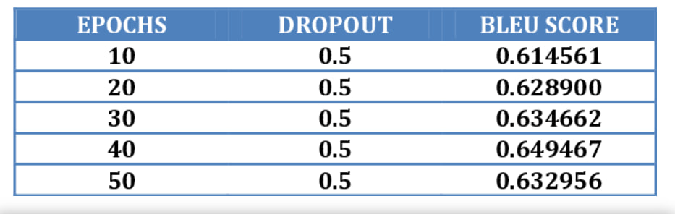
Koneru Lakshmaiah Education Foundation, Hyderabad(Aziz Nagar,Off Campus)
CNN And LSTM-Based Image Caption Generator
Marri Sahasra Reddy, Gopu Akshaya, Arika Asha Susmitha
Department of Computer Science and Engineering, Koneru Lakshmaiah Education Foundation, Hyderabad-500075, Telangana, India.
Abstract
Methods and Materials
Discussion
Our project’s purpose is to create an image caption generator using CNN and LSTM models that provide precise captions and describe the context of the given image. Our aim is to improve the analysis of pictures and understand the Characteristics of the key components and connections between them. By using large datasets of deep learning, we will create models that predict future outcomes. With the help of two individual neural network kinds i.e, CNN and LSTM which comes under the Recurrent neural network concept of deep learning gives machines the ability to understand the context of an image, allowing them to show it in a meaningful context.
The CNN and LSTM methods are the key components in an image caption generator that describe image content using natural language. The CNN is responsible for extracting features from the image, emphasizing significant visual elements. These extracted features are then handed over to the LSTM, which, in turn, generates a sequence of words to create a clear and meaningful caption. This combination of CNN and LSTM is essential for connecting the visual content in images with textual descriptions, making it a powerful tool for tasks such as automatic image captioning.
Image Caption Generator Algorithm Procedure:
Preprocessing and Dataset Loading.
CNN-LSTM Model Development.
Preparation of Data.
Model assemblage and instruction.
Generation of captions.
Discuss the real-world applications.
It also makes online shopping easier by describing products, and it saves time for people creating content by automatically writing image descriptions. This is great for websites and social media because it makes the content more interesting for users.
Identify the challenges and how to overcome.
Challenges include understanding context, handling diverse language descriptions, and ensuring model generalization. To overcome these challenges, solutions include using pre-trained models for context, training on diverse data for language, and regularizing models to prevent overfitting.
Figure 1. output screenshots
Figure 2. Generated caption
Introduction
Results
Conclusions
The "Image caption generator" term conveys the notion of our project.
The process of recognizing the contextuality of an image and annotating it with relevant captions is known as the Image caption generator. Image captioning is the task of automatically generating natural language descriptions for images.
Its intention is to innovate a software tool that can automatically generate human-readable and understandable language descriptions for different kinds of images.
We use deep learning techniques and computer vision to do feature extraction from Images. The deep learning methods that we utilize are CNN and LSTM models.
Recurrent neural network types are capable of handling sequential data where images can give accurate and precise language consistent captions. After presenting the image, the Model will understand the visual content and produce appropriate captions.
The main goal is to make the model effective, Combine visual information from images, and generate language skills to produce Texts that describe the context of the image.
.The image caption generator uses deep learning techniques for accurate image descriptions.
The deep learning model incorporates various technologies, including Computer Vision, Natural Language Processing, CNN, and LSTM.
These technologies collaborate to create descriptive text annotations for images.
CNN is essential for combining short-term and long-term memory effectively to generate clear captions.
LSTM plays a vital role in generating sequential and coherent image descriptions.
The performance of the image caption generator is assessed based on the accuracy of the generated captions, which should be both contextually accurate and grammatically correct.
An image caption generator utilizing CNN and LSTM represents a significant advancement in the field of computer vision and natural language processing. This technology offers the capability to provide accurate, clear, and contextually relevant descriptions for a wide range of images. The successful blend with deep learning techniques, such as CNN and LSTM, enables the generation of captions that bridge the gap between visual content and textual descriptions. This has wide-reaching applications across industries, from enhancing user engagement to improving assistive technologies, search and analysis, and efficient graphic reference and retrieval. The technology's accuracy, validated through comparisons to human references, underscores its effectiveness in generating high-quality image captions.
Table 1. Table for BLEU SCORE.
Chart 1.BLEU SCORE.
 | Heading | Heading | Heading
 | 800 | 790 | 4001
 | 356 | 856 | 290
 | 228 | 134 | 238
 | 954 | 875 | 976
 | 324 | 325 | 301
 | 199 | 137 | 186
Future Directions
Future advancements in CNN and LSTM-based image captioning involve multimodal learning to combine visual, auditory, and textual data. Enhanced context understanding and nuanced descriptions are on the horizon. Expanding to multiple languages, addressing ethical biases, real-time applications, and personalized captions are key areas of development for broader, more versatile utilization.
Contact Information
References
Acknowledgements
<Marri.Sahsra Reddy>
<KL University>
Email:2010030556@klh.edu.in
Website:https://github.com/2010030556/Image-Caption-Generator-Based-On-CNN-And-LSTM
Phone:9866237727
Portet F, Reiter E, Gatt A, Hunter J, Sripada S, Freer Y, Sykes C (2009). "Automatic Generation of Textual Summaries from Neonatal Intensive Care Data" (PDF). Artificial Intelligence.
Ian Goodfellow, Yoshua Bengio, Aaron Courville, Deep Learning, 2016
Richard Szeliski, Computer Vision: Algorithms and Applications, 2010.
Oriol Vinyals, Alexander Toshev, Samy Bengio, D. Computer ScienceIEEE Conference on Computer Vision and Pattern…2015
Quanzeng You, Hailin Jin, Zhaowen Wang, Chen Fang, and Jiebo Luo. Image captioning with semantic attention. Proceedings of the IEEE Conference on Computer Vision and Pattern Recognition, pages 4651–4659, 2016
6. R. Subash (November 2019): Automatic Image Captioning Using Convolution Neural Networks and LSTM
7 . Simao Herdade, Armin Kappeler, Kofi Boakye, Joao Soares (June 2019): Image Captioning: Transforming Objects into words.
8. Long Short-Term Memory, Hochreiter, Sepp and Schmidhuber, Jurgen, 1997.
We would like to thank the following people for their support and guidance without whom the completion of this project in fruition would not be possible. Dr. Pavan Kumar Pagadala, our project guide, for helping us and guiding us in the course of this project. Dr. Arpita Gupta, the Head of the Department, Department of Computer science of Engineering. Our internal reviewers, Mr.Faizan Ahmad, DR. Rajib Debnath, MS. N Anuradha for their insight and advice provided during the review sessions. We would also like to thank our individual parents and friends for their constant support.

